Slide 1
Message Passing and Node Classification
1

Slide 2
Outline
Main question today: Given a network with labels on some nodes, how do we assign labels to all other nodes in the network?
Example: In a network, some nodes are fraudsters and some other nodes are fully trusted. How do you find the other fraudsters and trustworthy nodes?
We already discussed node embeddings as a method to solve this

Slide 3


Example: Node Classification
?
?
?
?
?
Given labels of some nodes
Let’s predict labels of unlabeled nodes
This is called semi-supervised node classification

Slide 4
Outline
Today we will discuss some intuitions behind the framework: message passing
Intuition: Correlations exist in networks.
In other words: Similar nodes are connected
Key concept is collective classification: Idea of assigning labels to all nodes in a network together
We will look at some techniques today:
Relational classification
Iterative classification

Slide 5
Correlations in Networks
Individual behaviors are correlated in the network
Correlation: nearby nodes have the same color (belonging to the same class)

Slide 6
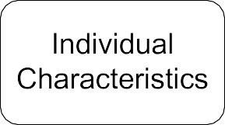
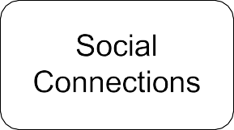
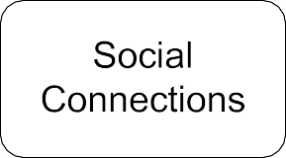
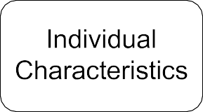
Correlations in Networks
Main types of dependencies that lead to correlation:
Homophily Influence

Slide 7


Homophily
Homophily: The tendency of individuals to associate and bond with similar others
“Birds of a feather flock together”
It has been observed in a vast array of network studies, based on a variety of attributes (e.g., age, gender, organizational role, etc.)
Example: Researchers who focus on the same research area are more likely to establish a connection (meeting at conferences, interacting in academic talks, etc.)
Homophily

Slide 8
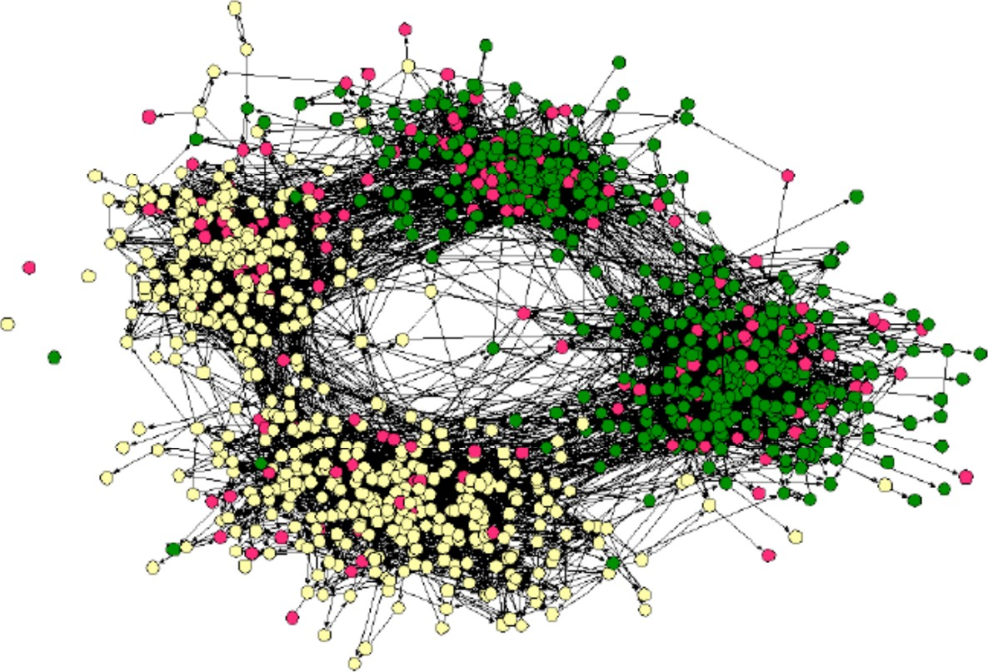
Homophily: Example
Example of homophily
Online social network
Nodes = people
Edges = friendship
Node color = interests (sports, arts, etc.)
People with the same
interest are more closely connected due to homophily
(Easley and Kleinberg, 2010)

Slide 9


Influence
Influence: Social connections can influence the individual characteristics of a person.
Example: I recommend my musical preferences to my friends, until one of them grows to like my same favorite genres!
Influence

Slide 10
Classification with Networks
How do we leverage this correlation observed in networks to help predict node labels?
Label 1
3
7
5
Label 0
1
4
9
8
6
Label 1
2
Label 0
How do we predict the labels for the nodes in grey?

Slide 11
Motivation
Similar nodes are typically close together or directly connected in the network:
Guilt-by-association: If I am connected to a node with label 𝑋, then I am likely to have label 𝑋 as well.
Example: Malicious/benign web page: Malicious web pages link to one another to increase visibility, look credible, and rank higher in search engines

Slide 12
Motivation
Classification label of a node 𝑣 in network may depend on:
Features of 𝑣
Labels of the nodes in 𝑣’s neighborhood
Features of the nodes in 𝑣’s neighborhood

Slide 13
Semi-supervised Learning
Formal setting
Given:
Graph
Few labelled nodes
?
Find: class (red/green) of remaining nodes
?
?
Main assumption: There is homophily in the network

Slide 14
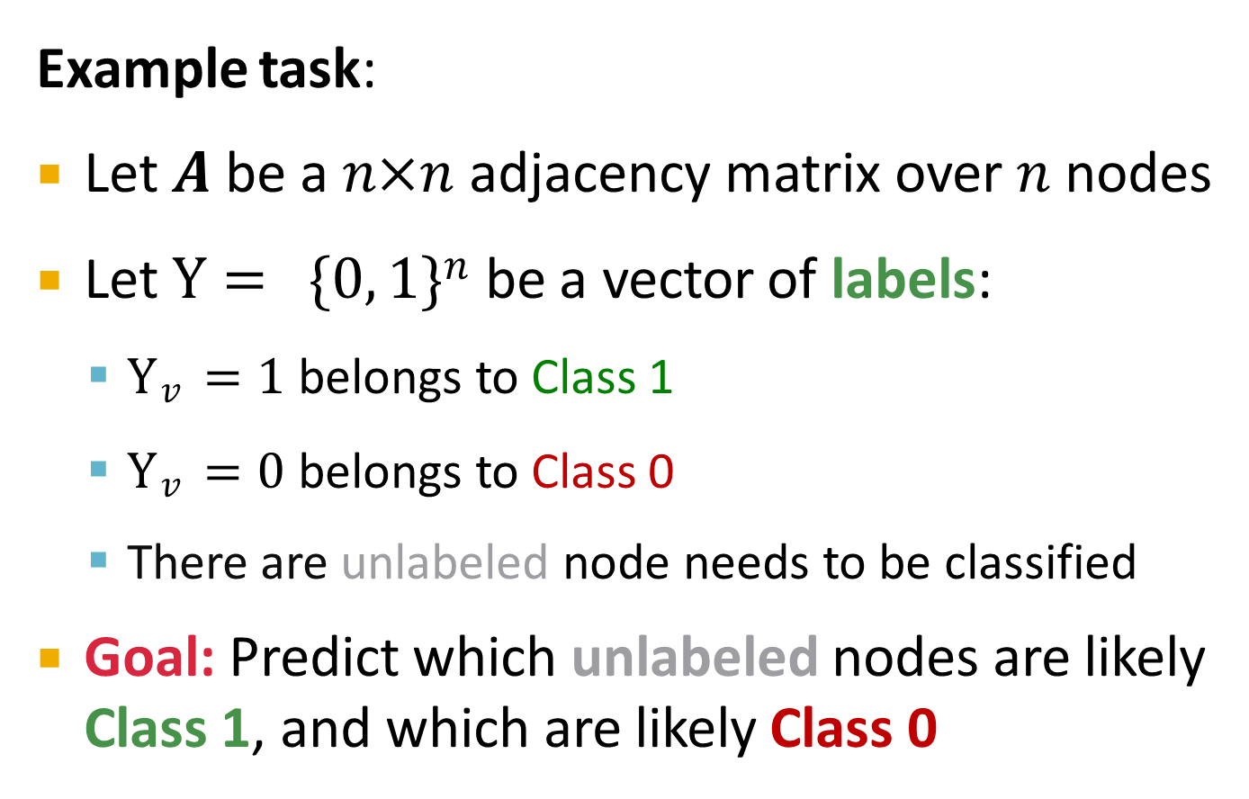
Semi-supervised Learning
Example task:
Let 𝑨 be a 𝑛×𝑛 adjacency matrix over 𝑛 nodes
Let Y = {0, 1}$n$be a vector of labels:
Y$v$ = 1 belongs to Class 1
Y$v$ = 0 belongs to Class 0
There are unlabeled node needs to be classified
Goal: Predict which unlabeled nodes are likely
Class 1, and which are likely Class 0

Slide 15
Collective Classification
Many applications:
Document classification
Part of speech tagging
Link prediction
Optical character recognition
Image/3D data segmentation
Entity resolution in sensor networks
Spam and fraud detection

Slide 16









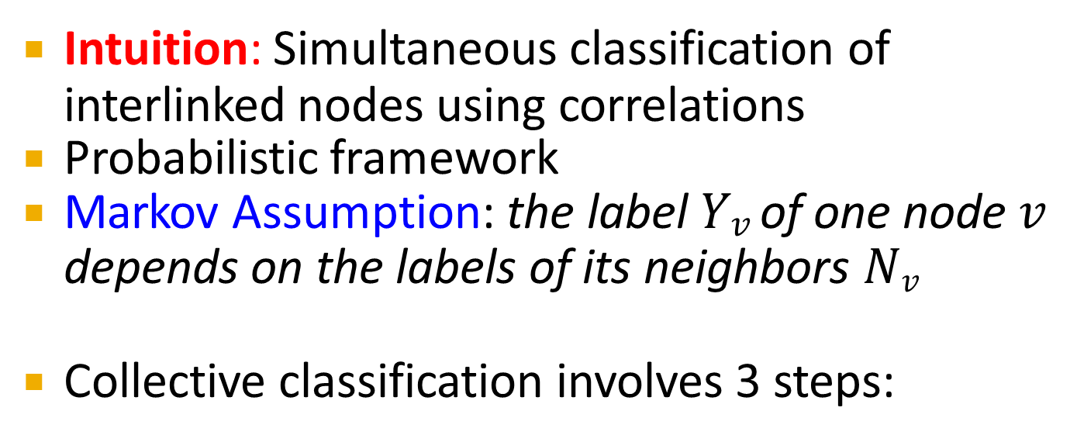
Collective Classification
Intuition: Simultaneous classification of interlinked nodes using correlations
Probabilistic framework
Markov Assumption: the label 𝑌$v$ of one node 𝑣
depends on the labels of its neighbors 𝑁_{𝑣}
Collective classification involves 3 steps:
Local Classifier
Relational Classifier
Collective Inference
Assign initial labels
Capture correlations between nodes
Propagate correlations through network

Slide 17






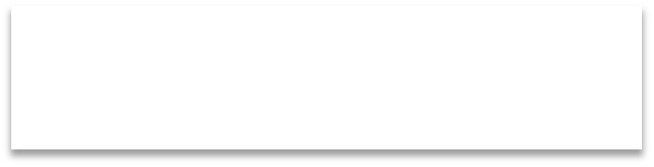


Collective Classification
Local Classifier
Local Classifier: Used for initial label assignment
Predicts label based on node attributes/features
Standard classification task
Does not use network information
Assign initial labels
Relational Classifier
Relational Classifier: Capture correlations
Learns a classifier to label one node based on the labels and/or attributes of its neighbors
This is where network information is used
Capture correlations between nodes
Collective Inference
Collective Inference: Propagate the correlation
Apply relational classifier to each node iteratively
Iterate until the inconsistency between neighboring labels is minimized
Network structure affects the final prediction
Propagate correlations through network

Slide 18
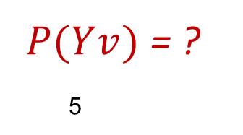
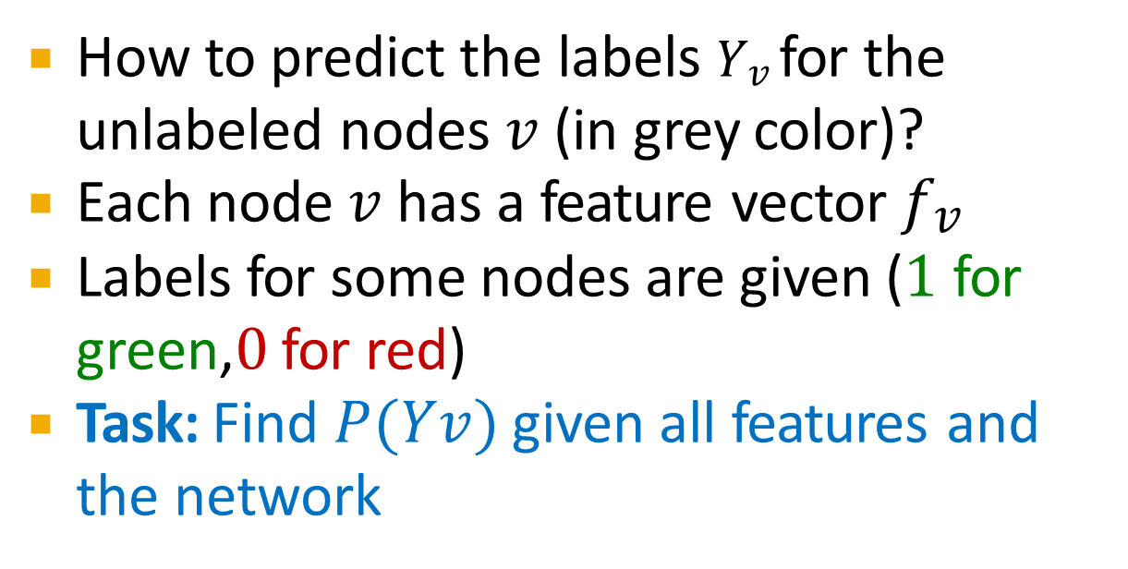
Problem Setting
How to predict the labels 𝑌$v$ for the unlabeled nodes 𝑣 (in grey color)?
Each node 𝑣 has a feature vector 𝑓$v$
Labels for some nodes are given (1 for green,0 for red)
Task: Find 𝑃(𝑌$v$) given all features and the network
𝑃(𝑌$v$) = ?
5
7
3
9
4
1
8
6
2

Slide 19
What next?
We focus on semi-supervised node classification
Intuition is based on homophily: Similar nodes are typically close together or directly connected
Techniques we will introduce:
Relational classification
Iterative classification

Slide 20
Relation Classification and Iterative Classification

Slide 21
Collective Classification Models
Relational classifiers
Iterative classification

Slide 22
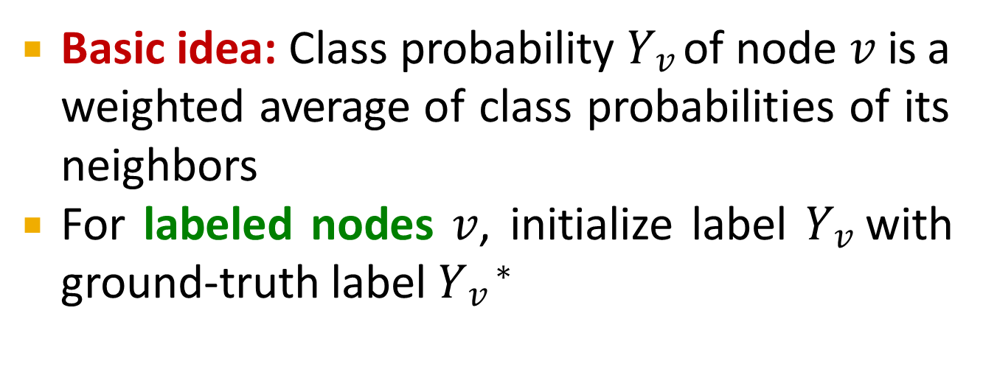
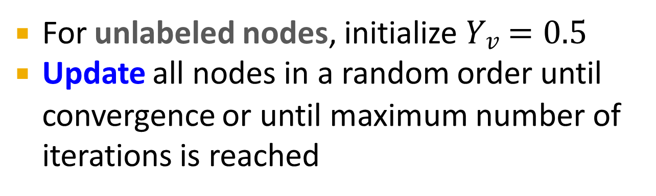
Probabilistic Relational Classifier
Basic idea: Class probability 𝑌$v$ of node 𝑣 is a weighted average of class probabilities of its neighbors
For labeled nodes 𝑣, initialize label 𝑌$v$ with ground-truth label 𝑌$v$∗
For unlabeled nodes, initialize 𝑌$v$ = 0.5
Update all nodes in a random order until
convergence or until maximum number of iterations is reached

Slide 23
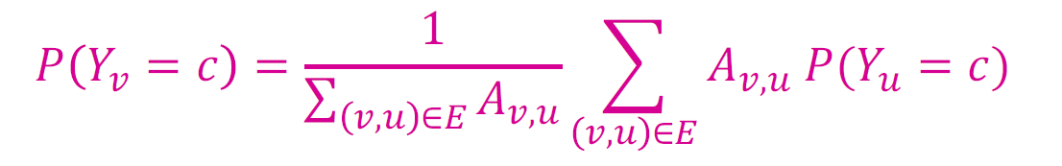
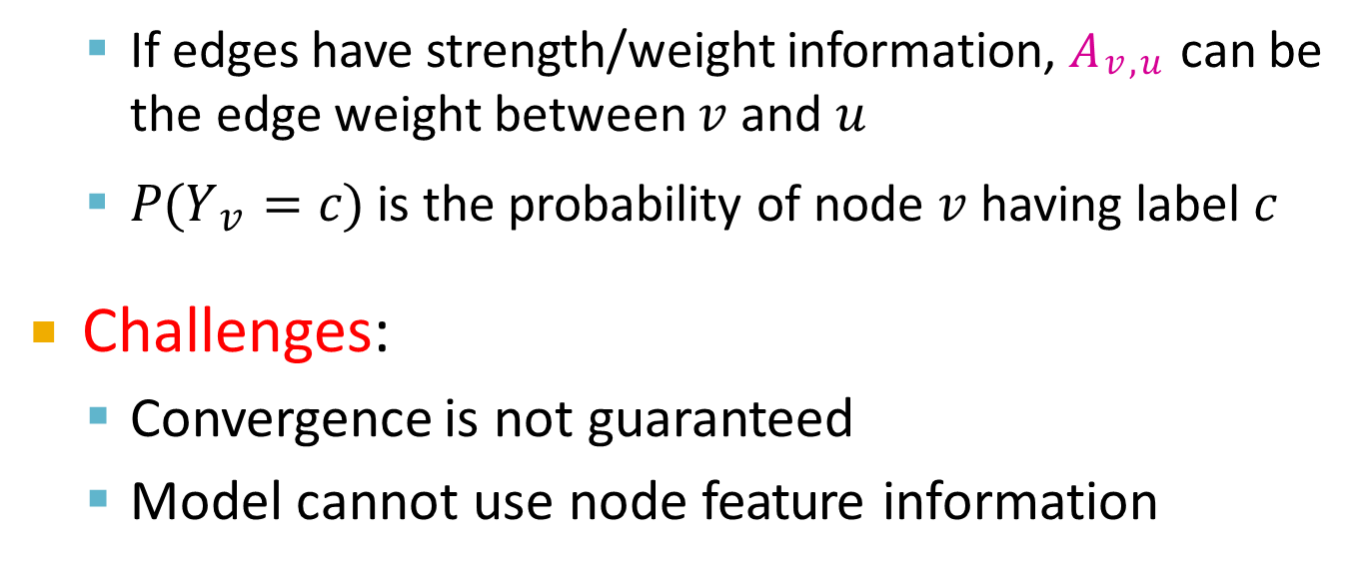
Probabilistic Relational Classifier
Update for each node 𝑣 and label 𝑐 (e.g. 0 or 1)
If edges have strength/weight information, 𝐴$v$,$u$ can be the edge weight between 𝑣 and 𝑢
𝑃(𝑌$v$ = 𝑐) is the probability of node 𝑣 having label 𝑐
Challenges:
Convergence is not guaranteed
Model cannot use node feature information

Slide 24
Initialization
Initialization:
All labeled nodes with their labels
All unlabeled nodes 0.5 (belonging to class 1 with probability 0.5)
Let 𝑃_{Y1} = 𝑃 ( 𝑌₁ = 1)
𝑃_{Y3} = 0.5
3
𝑃_{Y} = 1
7
𝑃 = 0.5
5
7
Y₅
4
𝑃_{Y4} = 0.5
9
𝑃 = 0.5
1
Y₉
𝑃_{Y} = 0
6
𝑃_{Y6} = 1
1
8
𝑃_{Y}= 0.5
2
𝑃_{Y2} = 0
8

Slide 25
1st Iteration, Update Node 3
Update for the 1st Iteration:
For node 3, 𝑁₃ = {1, 2, 4}
𝑃(𝑌₃) =
0 + 0 + 0.5 /3 = 0.17
𝑃(𝑌₇) = 1
7
𝑃(𝑌₅) = 0.5
5
3
9
𝑃(𝑌₉) = 0.5
4
𝑃(𝑌₄) = 0.5
1
8
𝑃(𝑌₈) = 0.5
6
𝑃(𝑌₆) = 1
𝑃(𝑌1) = 0
2
𝑃(𝑌₂) = 0

Slide 26
1st Iteration, Update Node 4
Update for the 1st Iteration:
For node 4, 𝑁₄ = {1, 3, 5, 6}
𝑃(𝑌₇) = 1
7
𝑃(𝑌₃) = 0.17
3
𝑃(𝑌 ) = 0.5
5
5
9
𝑃(𝑌₉) = 0.5
4
1
6
𝑃(𝑌₆) = 1
𝑃(𝑌₄)
= 0 + 0.17 + 0.5 + 1 /4
= 0.42
𝑃(𝑌 ) = 0
8
𝑃(𝑌₈) = 0.5
1
2
𝑃(𝑌₂) = 0
After Node 3 is updated

Slide 27
1st Iteration, Update Node 5
Update for the 1st Iteration:
For node 5, 𝑁₅ = {4, 6, 7, 8}
After nodes 3 and 4 are updated
𝑃 𝑌₅
= 1 + 0.5 + 1 + 0.42 /4
= 0.73
𝑃(𝑌₇) = 1
7
3
𝑃(𝑌 ) = 0.17
5
3
9
𝑃(𝑌₉) = 0.5
4
𝑃(𝑌₄) = 0.42
1
𝑃(𝑌 ) = 0
8
𝑃(𝑌₈) = 0.5
6
𝑃(𝑌₆) = 1
1
2
𝑃(𝑌₂) = 0

Slide 28
End of 1st Iteration
After Iteration 1 (a round of updates for all unlabeled nodes)
𝑃(𝑌₇) = 1
7
𝑃(𝑌₃) = 0.17
𝑃(𝑌 ) = 0.73
5
3
5
9
𝑃(𝑌₉) = 1
4
𝑃(𝑌₄) = 0.42
1
6
𝑃(𝑌₆) = 1
𝑃(𝑌 ) = 0
8
𝑃(𝑌₈) = 0.91
1
2
𝑃(𝑌₂) = 0

Slide 29
After 2nd Iteration
After Iteration 2
𝑃(𝑌₇) = 1
7
𝑃(𝑌₃) = 0.14
3
𝑃(𝑌 ) = 0.85
5
5
9
𝑃(𝑌₉) = 1
Converged
4
𝑃(𝑌₄) = 0.47
1
𝑃(𝑌 ) = 0
6
1
8
𝑃(𝑌₈) = 0.95
𝑃(𝑌₆) = 1
2
𝑃(𝑌₂) = 0

Slide 30
After 3rd Iteration
After Iteration 3
𝑃(𝑌₇) = 1
7
𝑃(𝑌₃) = 0.16
3
𝑃(𝑌 ) = 0.86
5
5
9
𝑃(𝑌₉) = 1
Converged
4
𝑃(𝑌₄) = 0.5
1
6
𝑃(𝑌₆) = 1
𝑃(𝑌 ) = 0
8
1
𝑃(𝑌₈) = 0.95
2
Converged
𝑃(𝑌₂) = 0

Slide 31
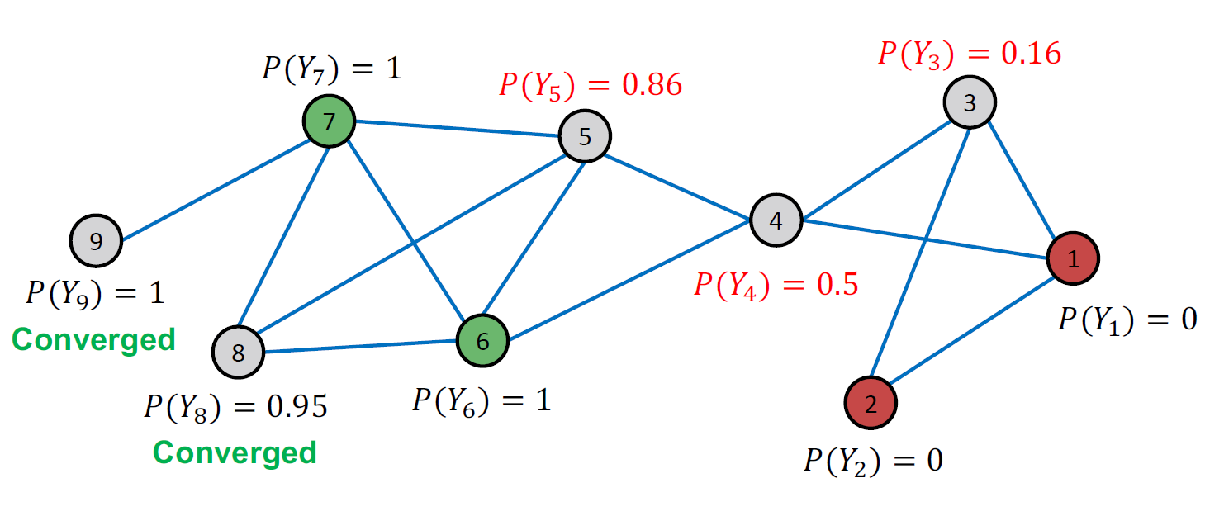
After 4th Iteration
After Iteration 4

Slide 32
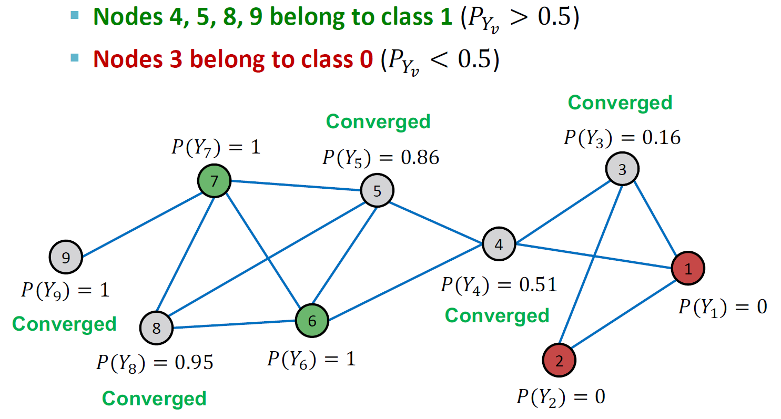
Convergence
All scores stabilize after 4 iterations. We therefore predict:
32

Slide 33
Collective Classification Models
Relational classifiers
Iterative classification

Slide 34
Iterative Classification
Relational classifiers do not use node attributes. How can one leverage them?
Main idea of iterative classification: Classify node 𝑣 based on its attributes 𝒇_{𝒗} as well as labels 𝒛_{𝒗} of neighbor set 𝑵_{𝒗}

Slide 35
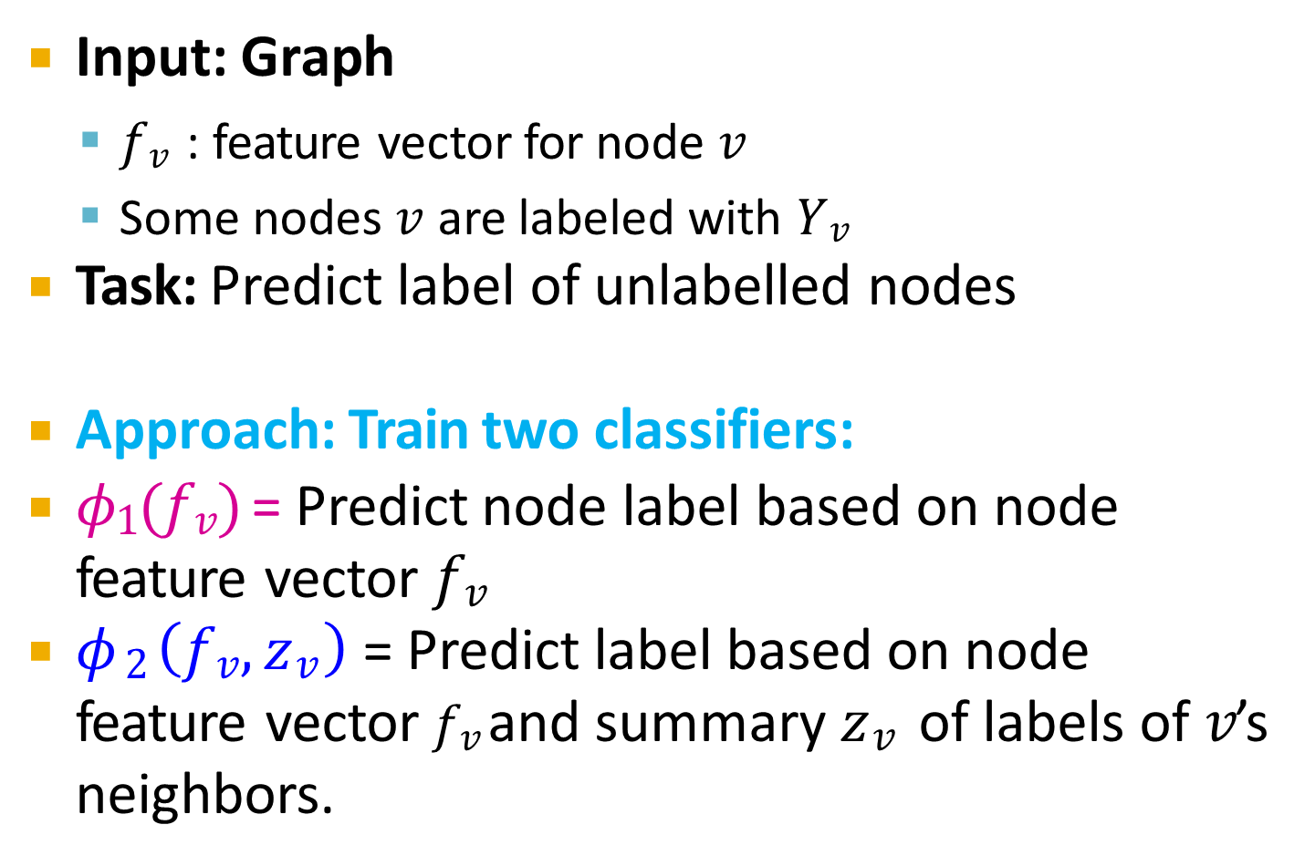
Iterative Classification
Input: Graph
𝑓$v$ : feature vector for node 𝑣
Some nodes 𝑣 are labeled with 𝑌$v$
Task: Predict label of unlabelled nodes
Approach: Train two classifiers:
𝜙₁(𝑓$v$) = Predict node label based on node feature vector 𝑓$v$
𝜙$2 \left(fv, zv\right)$= Predict label based on node feature vector 𝑓$v$and summary 𝑧$v$ of labels of 𝑣’s neighbors.

Slide 36
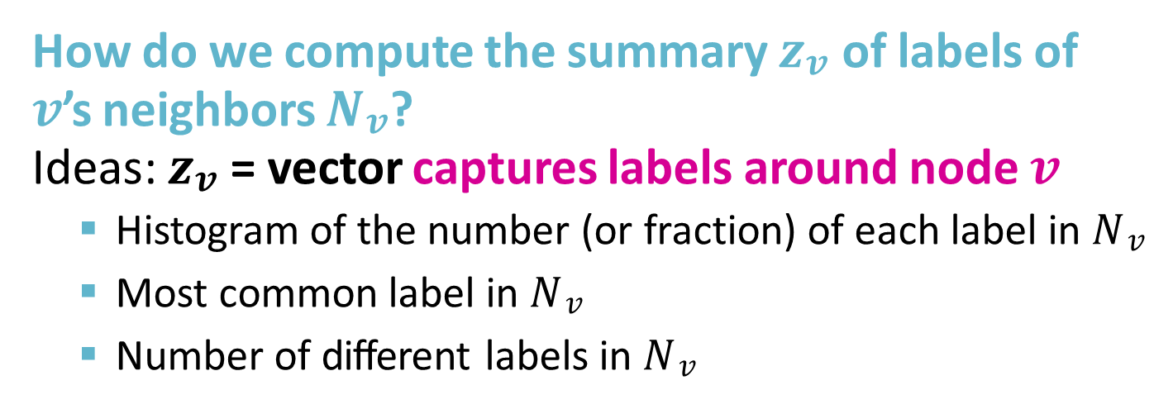
Computing Summary 𝒛_{𝒗}
How do we compute the summary 𝒛_{𝒗} of labels of
𝒗’s neighbors 𝑵_{𝒗}?
Ideas: 𝒛_{𝒗} = vector captures labels around node 𝒗
Histogram of the number (or fraction) of each label in 𝑁$v$
Most common label in 𝑁$v$
Number of different labels in 𝑁$v$
𝒇_{𝒗}, 𝒛_{𝒗}

Slide 37
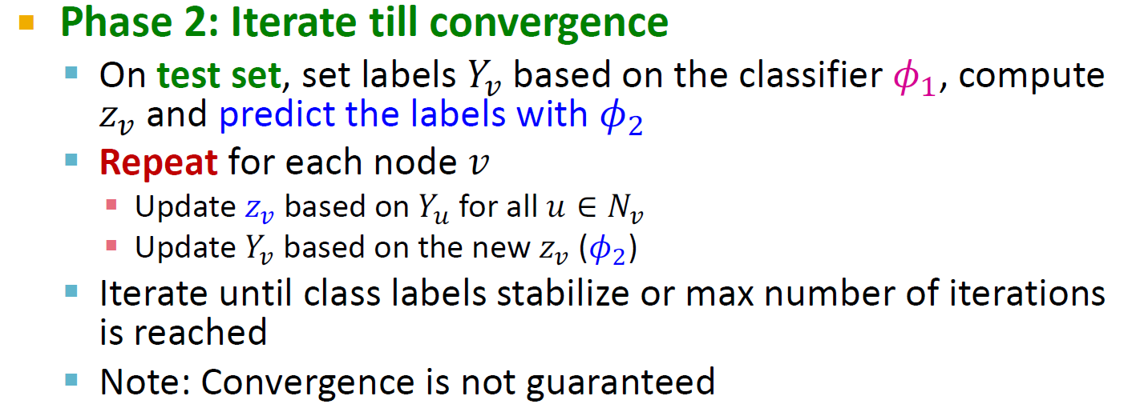
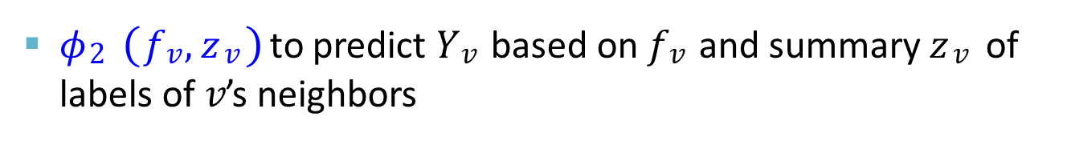
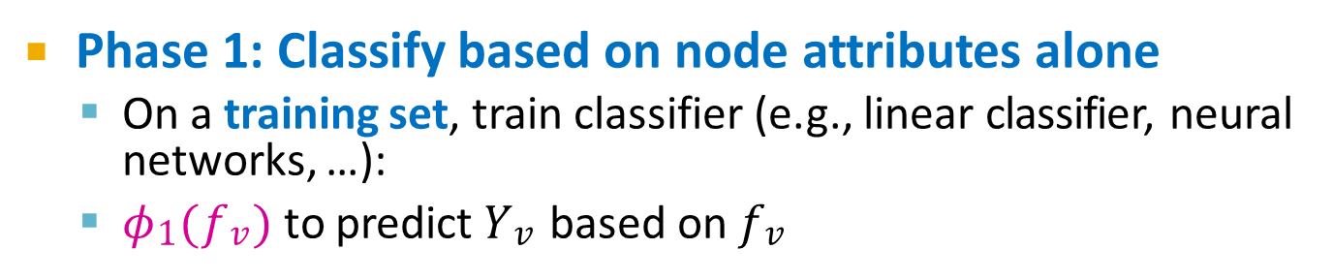
Architecture of Iterative Classifiers
Phase 1: Classify based on node attributes alone
On a training set, train classifier (e.g., linear classifier, neural networks, …):
𝜙₁(𝑓$v$) to predict 𝑌$v$ based on 𝑓$v$
𝜙₂ (𝑓$v$, 𝑧$v$)to predict 𝑌$v$ based on 𝑓$v$ and summary 𝑧$v$ of labels of 𝑣’s neighbors

Slide 38
Example: Web Page Classification
Input: Graph of web pages
Node: Web page
Edge: Hyper-link between web pages
Directed edge: a page points to another page
Node features: Webpage description
For simplicity, we only consider 2 binary features
Task: Predict the topic of the webpage

Slide 39
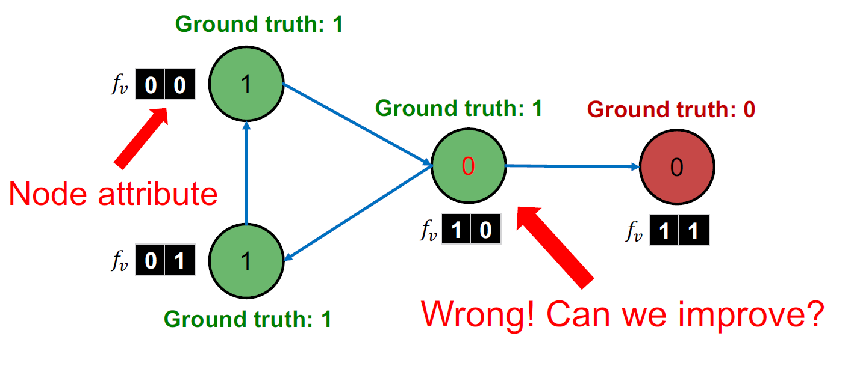
Example: Web Page Classification
Baseline: train a classifier (e.g., linear classifier) to classify pages based on binary node attributes.
39

Slide 40
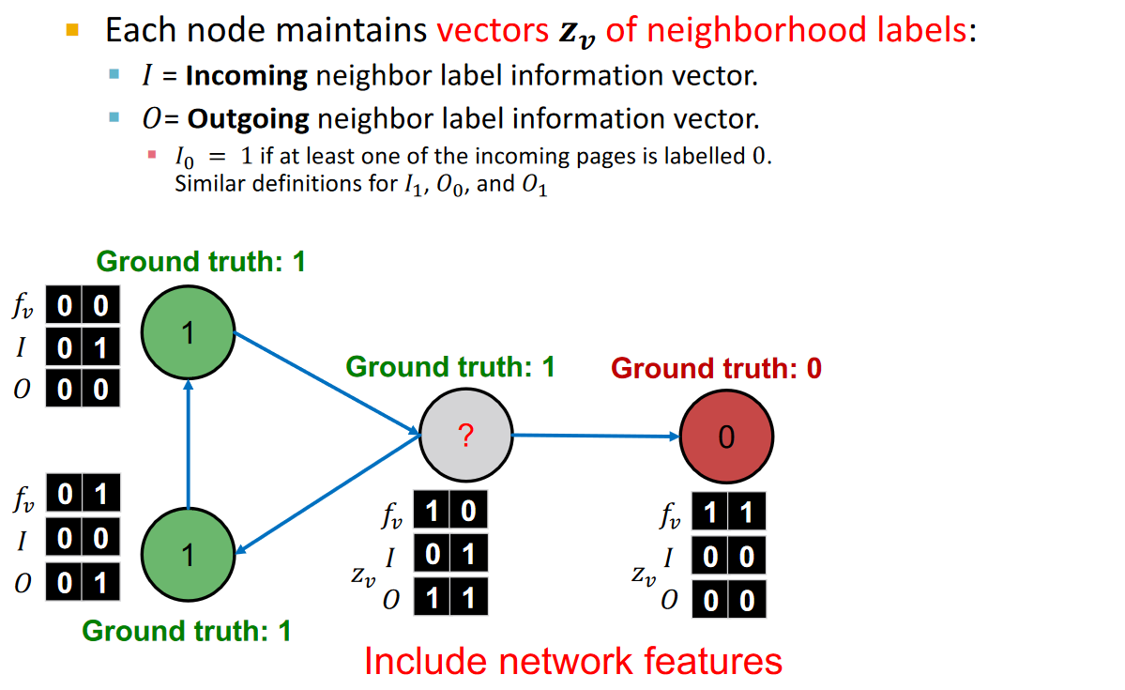
Example: Web Page Classification
𝒛_{𝒗}
𝒛_{𝒗}
40

Slide 41
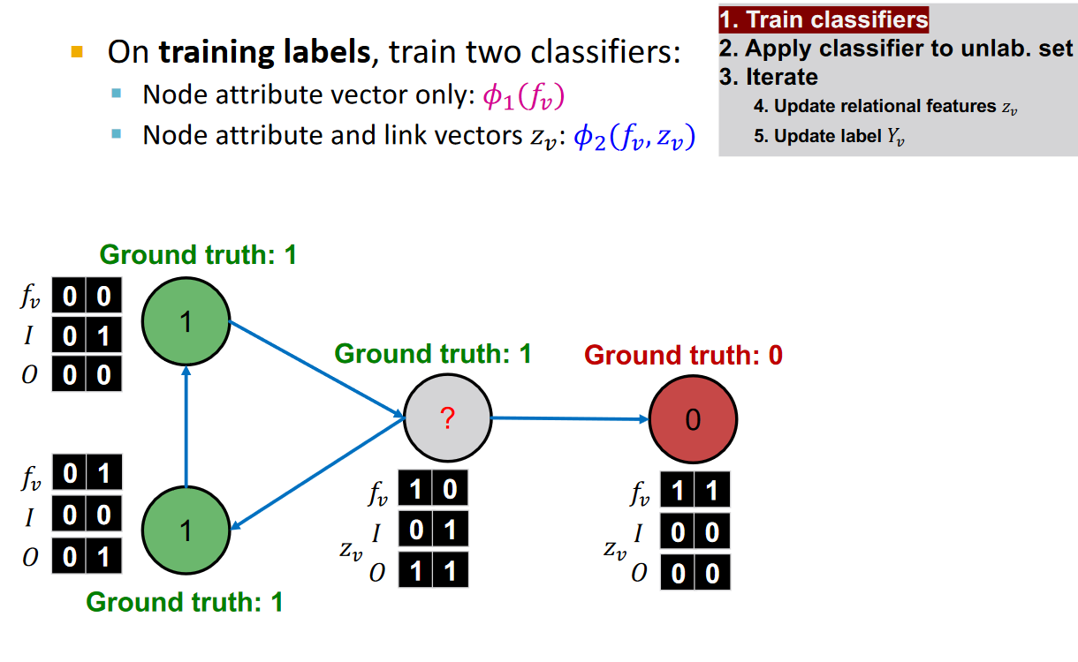
Iterative Classifier – Step 1
𝒛_{𝒗}
𝒛_{𝒗}
41

Slide 42
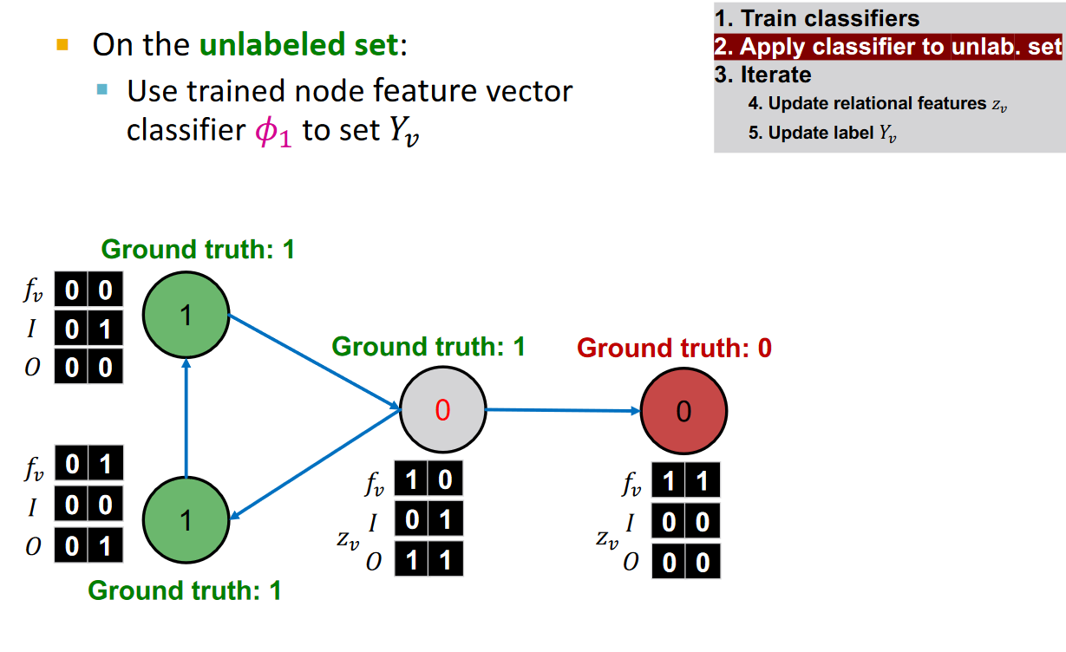
Iterative Classifier – Step 2
𝒛_{𝒗}
𝒛_{𝒗}
42

Slide 43
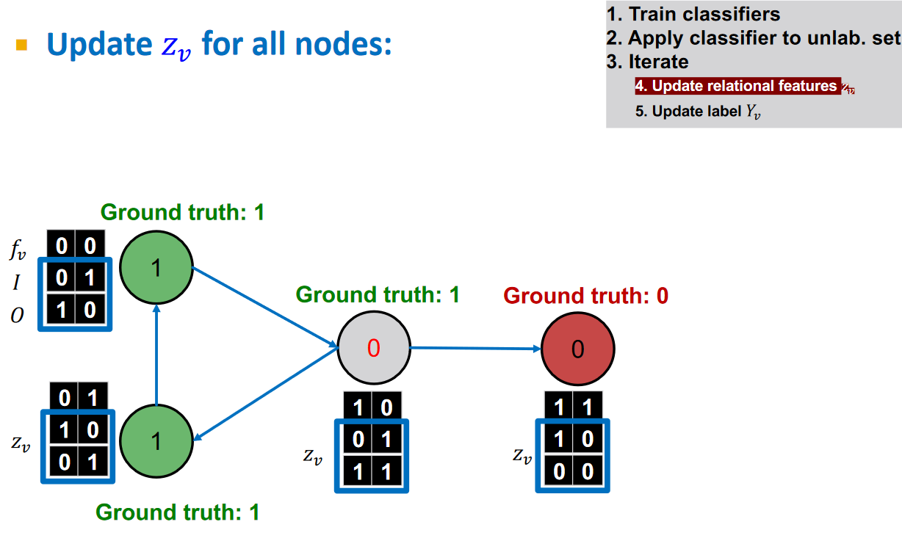
Iterative Classifier – Step 4
𝒛_{𝒗}
43

Slide 44
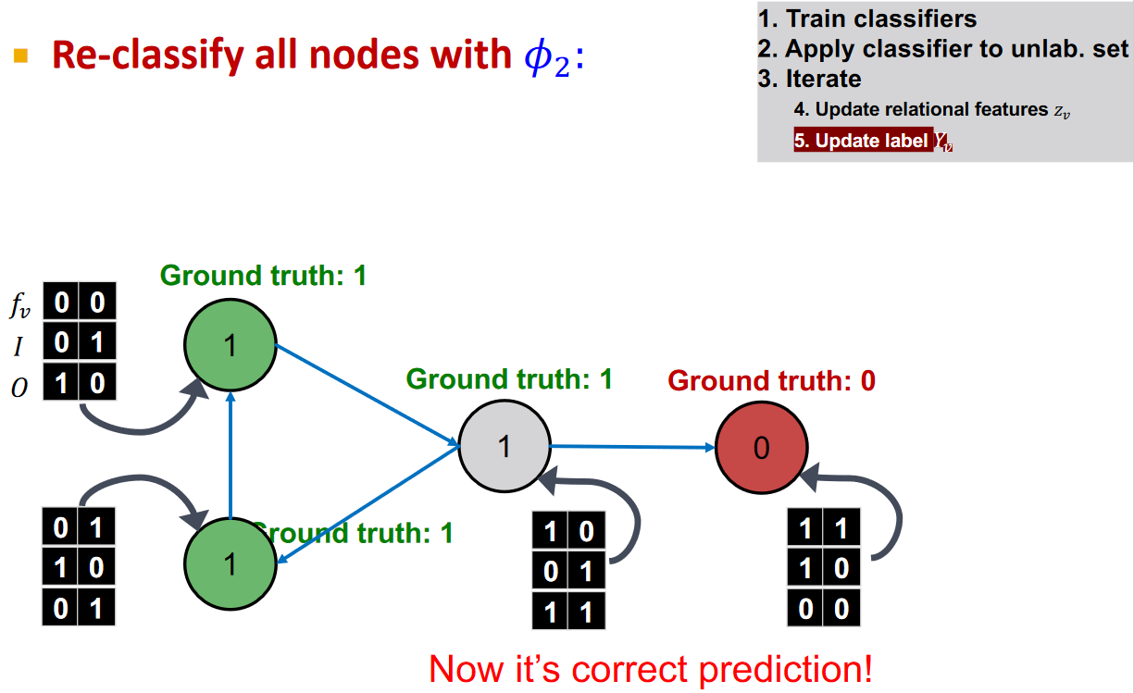
Iterative Classifier – Step 5
𝒛_{𝒗}
44

Slide 45
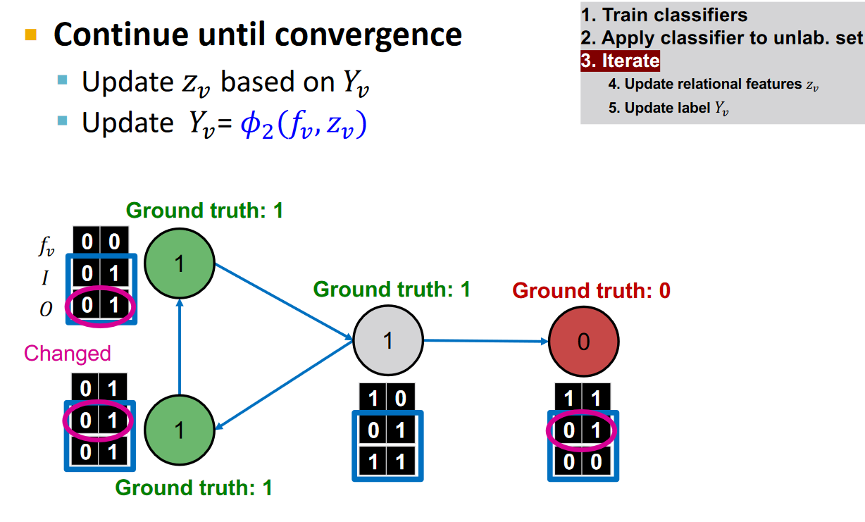
Iterative Classifier - Iterate
45

Slide 46
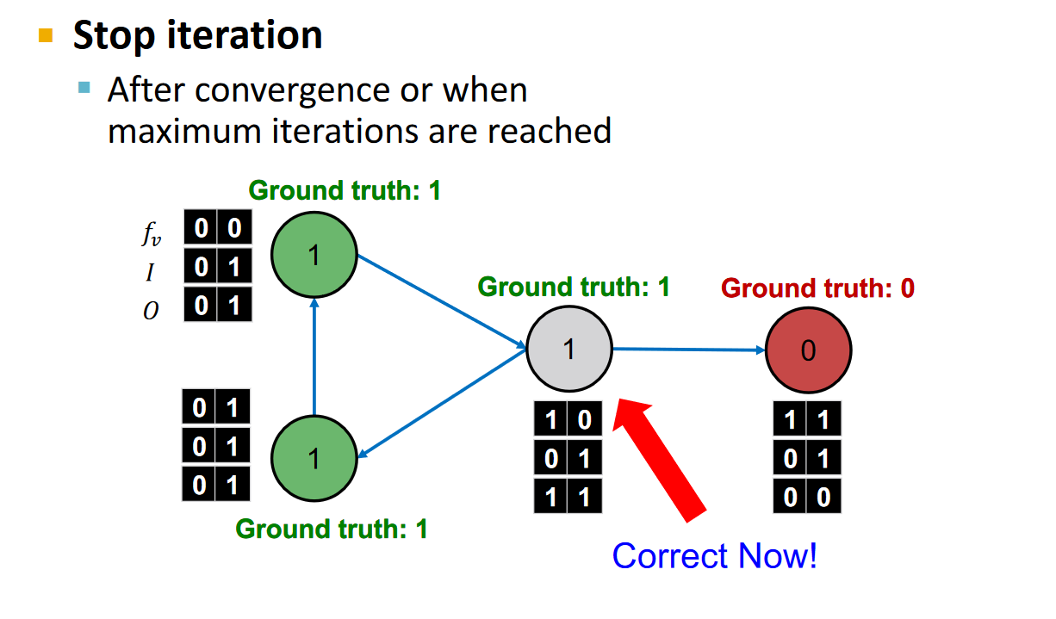
Iterative Classifier – Prediction
46

Slide 47
Summary
We talked about 2 approaches to collective classification
Relational classification
Iteratively update probabilities of node belonging to a label class based on its neighbors
Iterative classification
Improve over collective classification to handle attribute/feature information
Classify node 𝑖 based on its features as well as
labels of neighbors

